Slide 1

A Tale of Two Stabilities: Longitudinal Dynamic Personality Networks
Emorie D. Beck and Joshua J. Jackson
Washington University in St. Louis

Slide 2
Background | Methods | Temporal | Contemporaneous | Conclusions
Extraversion
Agreeableness
Conscientiousness
Neuroticism
Openness
DICTIONARY
Nomothetic
John, Naumann, & Soto, 2008; Cervone & Beck, 2017

Slide 3
Background | Methods | Temporal | Contemporaneous | Conclusions
Extraversion
Agreeableness
Conscientiousness
Neuroticism
Openness
Nomothetic
John, Naumann, & Soto, 2008; Cervone & Beck, 2017

Slide 4
Background | Methods | Temporal | Contemporaneous | Conclusions
Extraversion
Agreeableness
Conscientiousness
Neuroticism
Openness
Idiographic
John, Naumann, & Soto, 2008; Cervone & Beck, 2017

Slide 5

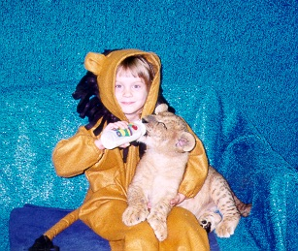


Personality Development
Background | Methods | Temporal | Contemporaneous | Conclusions
Roberts & Caspi, 2003

Slide 6
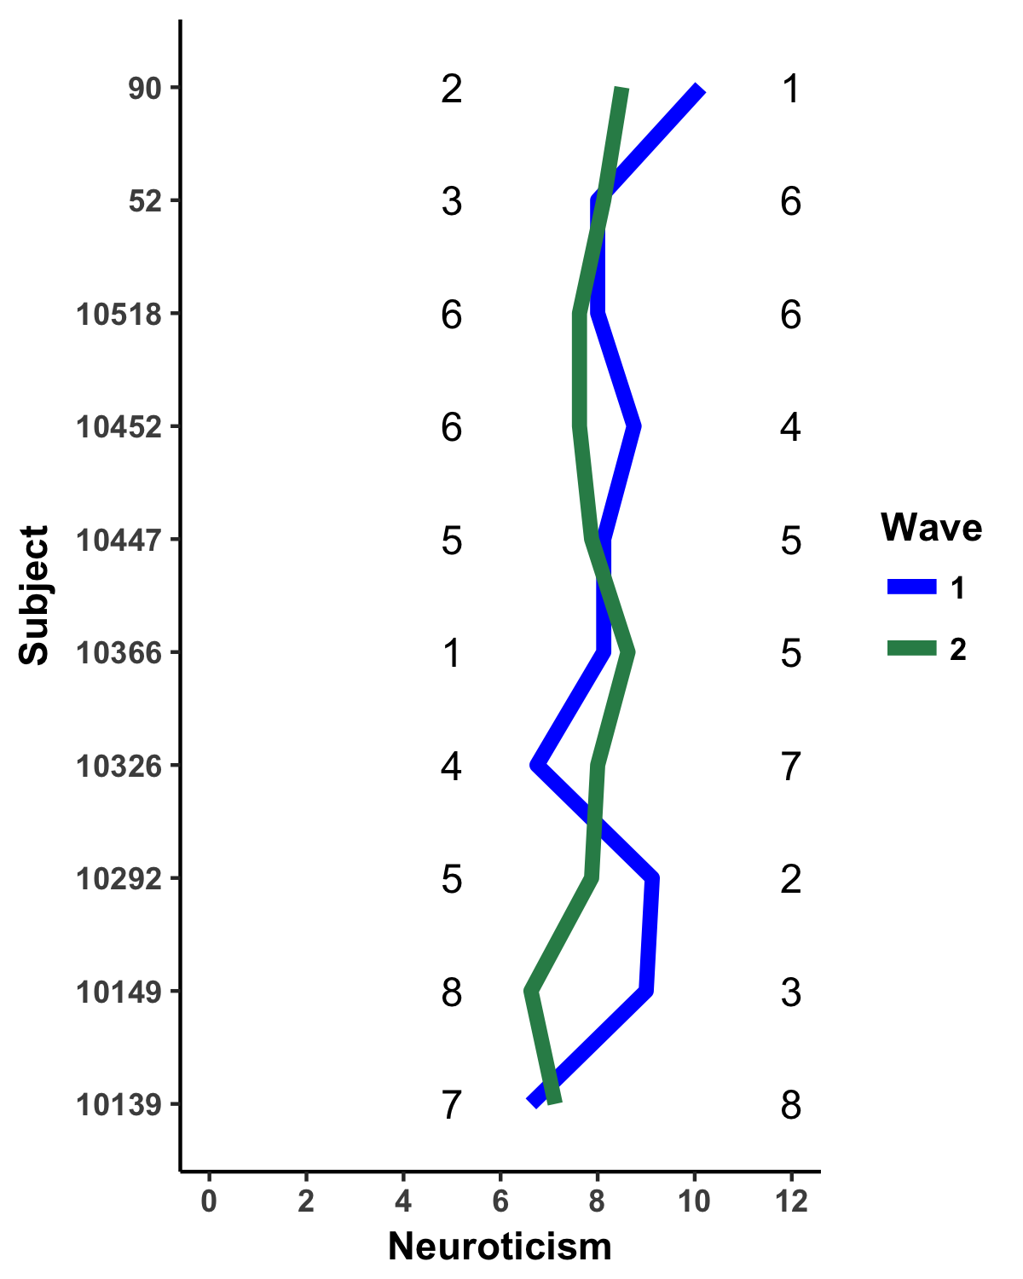
Personality Development
Background | Methods | Temporal | Contemporaneous | Conclusions
Typical Approaches to consistency:
Absolute change
Rank-order consistency
Ipsative consistency
Suggests that personality is relatively stable over time and exhibits normative changes
BUT there are individual differences in change
The Big 5
Extraversion
Agreeableness
Conscientiousness
Neuroticism
Openness to Experience
Caspi & Roberts (1990); Roberts et al. (2006); Mroczek & Spiro (2003)

Slide 7
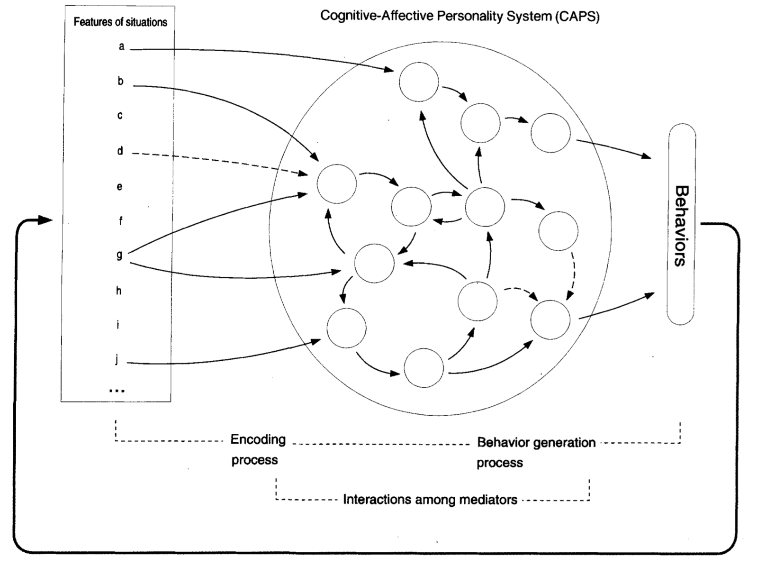
Personality Processes
Background | Methods | Temporal | Contemporaneous | Conclusions
Mischel & Shoda (1995)

Slide 8
Personality Processes
Background | Methods | Temporal | Contemporaneous | Conclusions
Experience Sampling Methods (ESM)
Mischel & Shoda (1995)

Slide 9
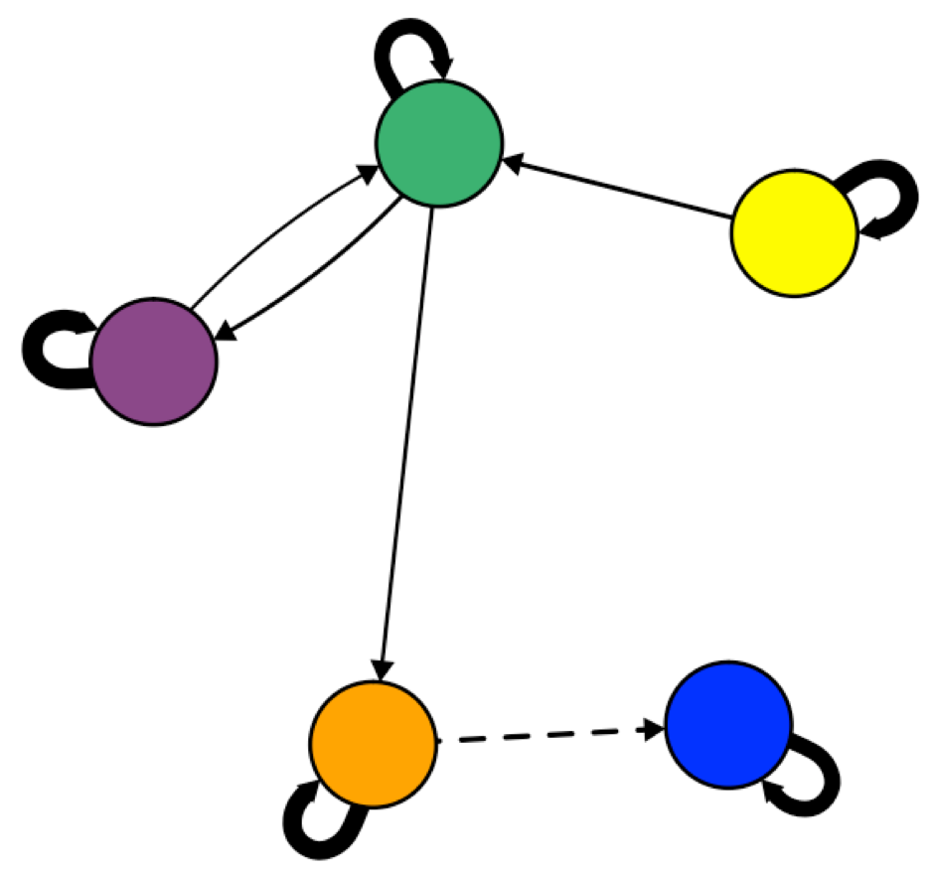
Background | Methods | Temporal | Contemporaneous | Conclusions
Idiographic
Notes:
Such data allows us to capture variability in psychological processes and behavior at the individual level that are missed with broad measures.
Moreover, when coupled with a network approach, ESM data can be used to create network models can for individual people, allowing for unique interdependencies among responses.
Such an approach has the advantage of allowing us to model personality closer to the level of a person. In other words, we can model unique relationships among the individuals self-reported observable and unobservable experiences, which may finally allow us to answer the question of whether ideographic assessments of personality do stack up to the power of nomothetic assessments.

Slide 10
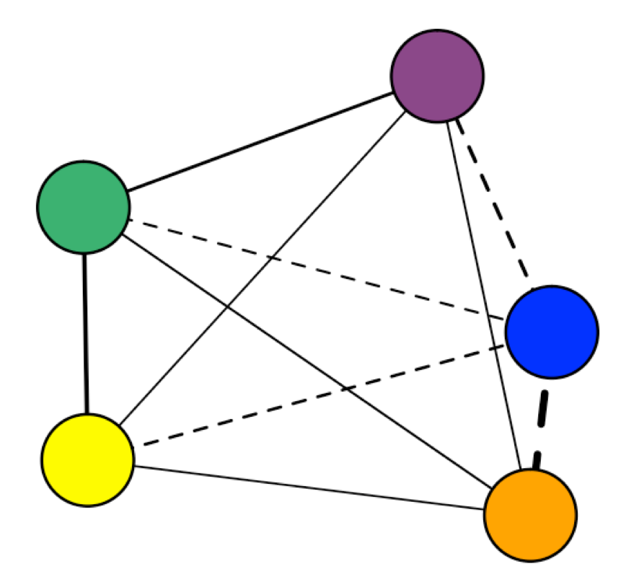
Background | Methods | Temporal | Contemporaneous | Conclusions
Concurrent behaviors:
While…
Contingent behaviors:
If… Then…
Within Time-Points: X_{i}←→Y_{i}
Between-Time Points: X_{i} → Y_{i+1}
Wild et al. (2010); Epskamp, Waldorp, Mõttus, & Borsboom, 2016)

Slide 11
Questions
Background | Methods | Temporal | Contemporaneous | Conclusions
How stable are networks of personality over time?
What are the structures of individual level personality networks?
Are there individual differences in idiographic personality networks?

Slide 12
Methods
Background | Methods | Temporal | Contemporaneous | Conclusions
2 years of ESM responses from the Personality and Intimate Relationships Study (PAIRS)
N = 372 Wash U undergrads, total assessments N = 17,715
Measures
9 items from the Big Five Inventory (BFI)
Procedure
4 assessments / day for 15 days
N1: Relaxed
N2: Depressed
N3: Worried
E1: Quiet
E2: Outgoing
A1: Rude
A2: Kind
C1: Lazy
C2: Reliable

Slide 13
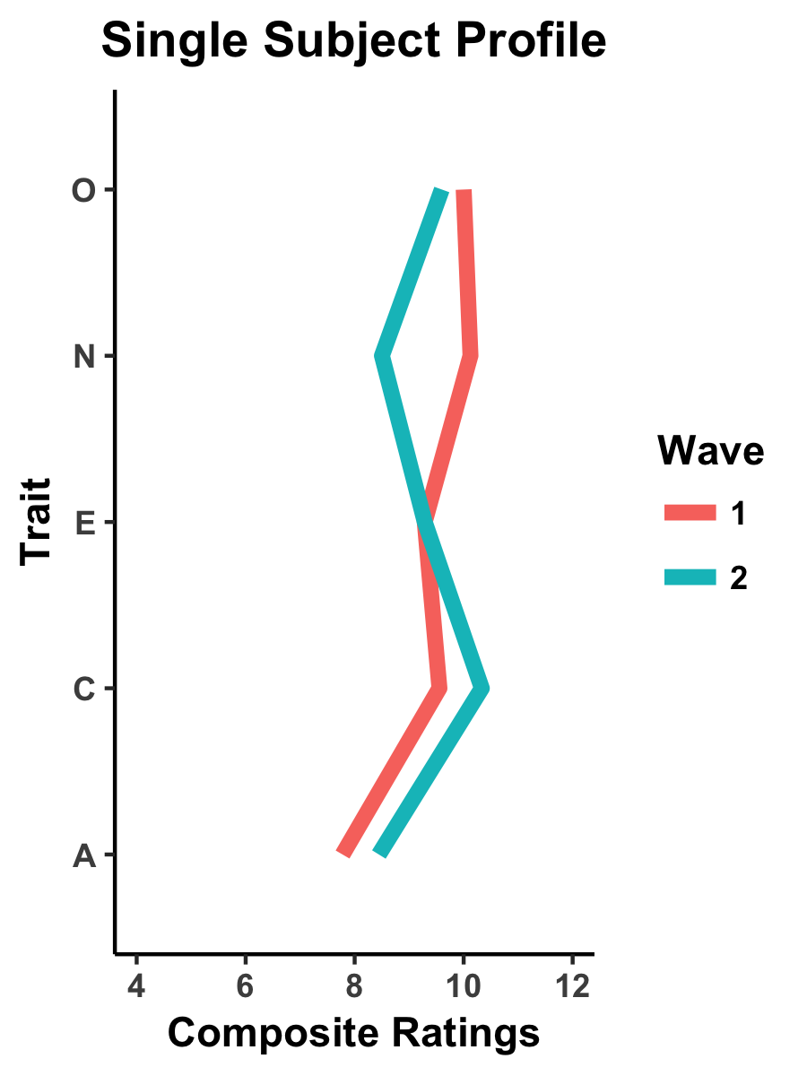
Stability
Idiographic
Results
Temporal
Contemporaneous
Ipsative Correlations
Absolute Change
Rank-Order Correlations
Edge Weights

Slide 14
+ 4 hr
Results
Individual Level Temporal Networks

Slide 15
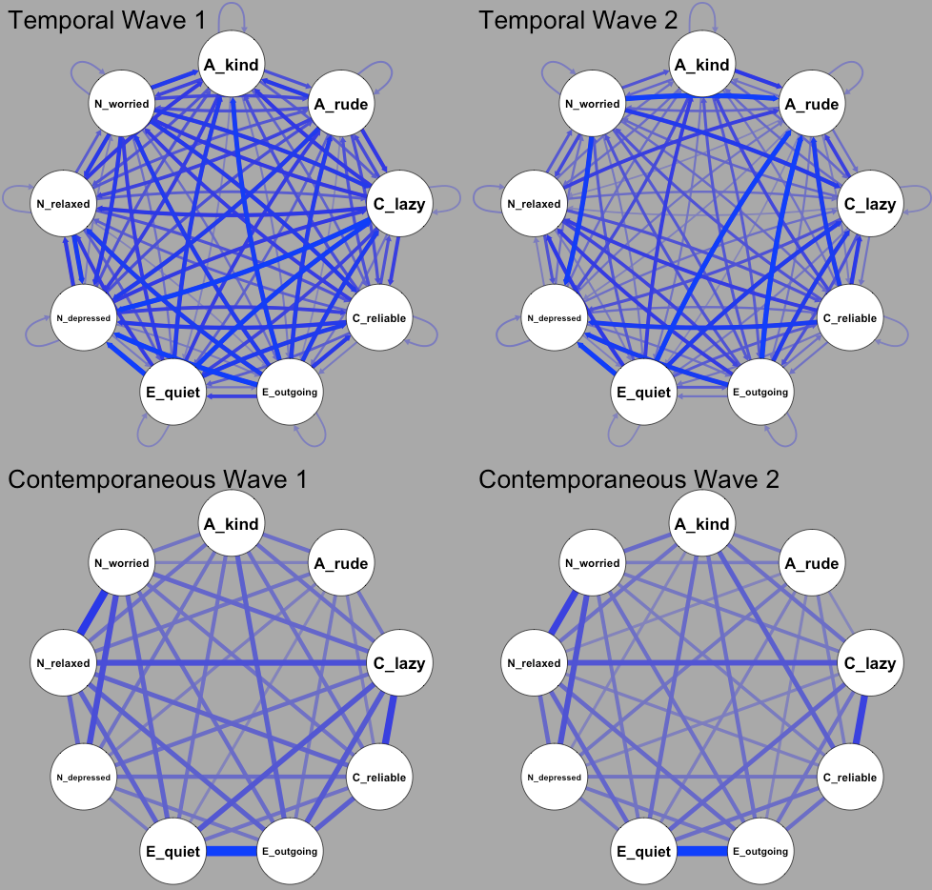
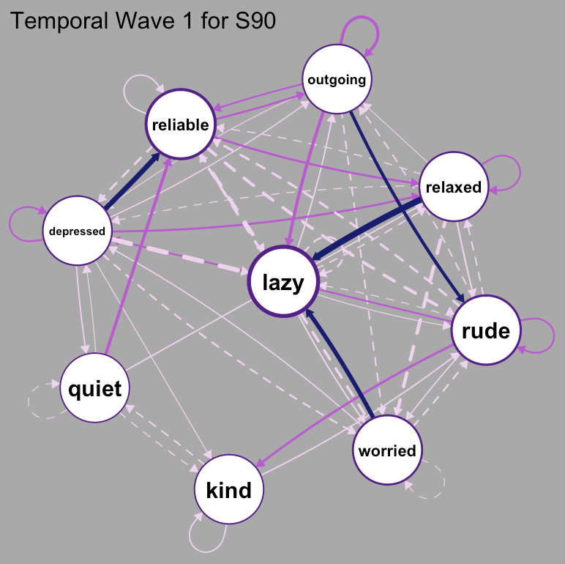
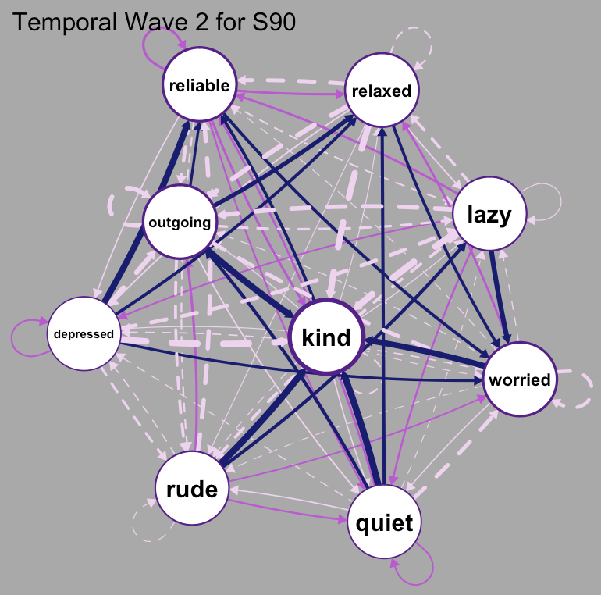
Individual Level Temporal Personality Network Stability
Background | Methods | Temporal | Contemporaneous | Conclusions
N1: Relaxed
N2: Depressed
N3: Worried
E1: Quiet
E2: Outgoing
A1: Rude
A2: Kind
C1: Lazy
C2: Reliable
Subject 90
Want to see more? https://emoriebeck.shinyapps.io/pairs_graphicalvar/

Slide 16
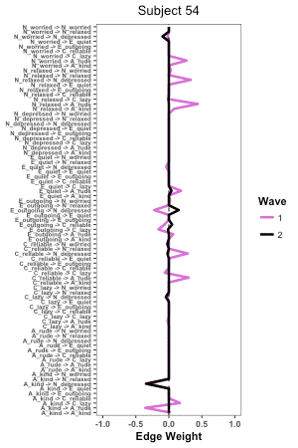
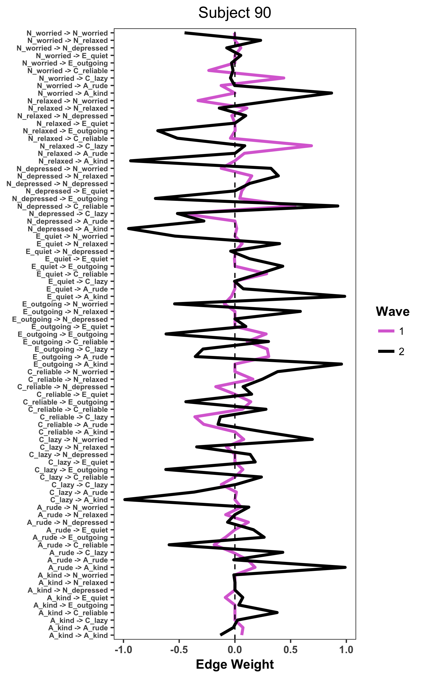
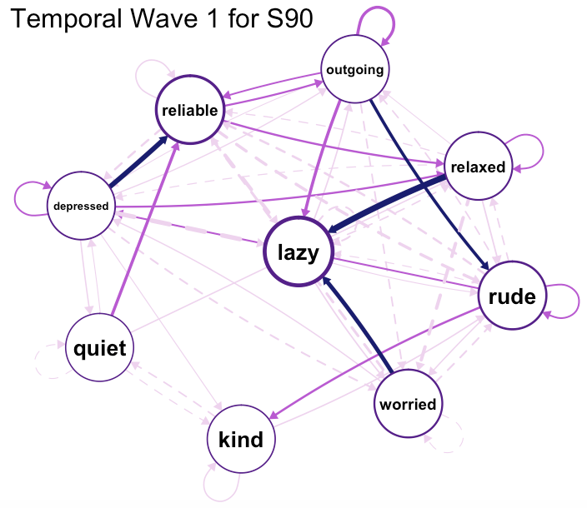
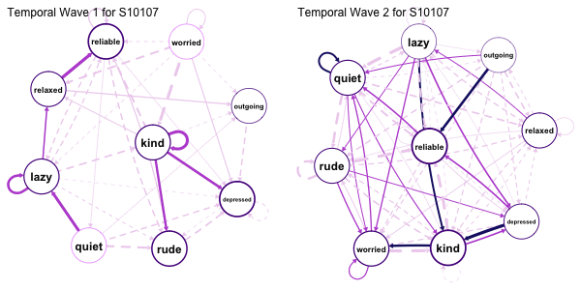
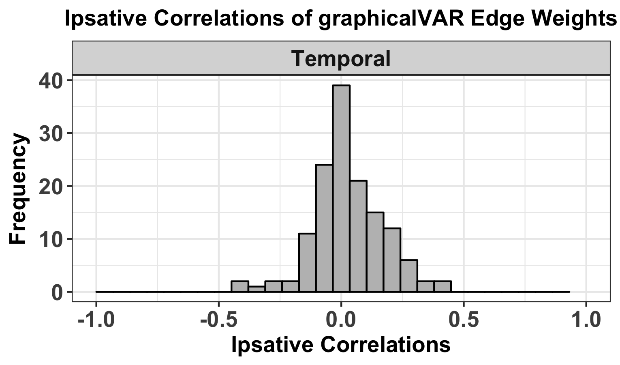
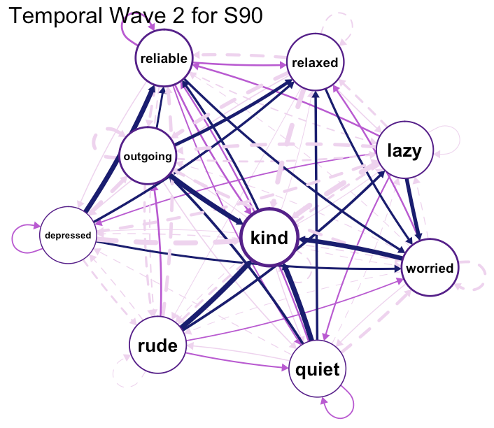
Individual Level Temporal Personality Network Stability
Background | Methods | Temporal | Contemporaneous | Conclusions
N1: Relaxed
N2: Depressed
N3: Worried
E1: Quiet
E2: Outgoing
A1: Rude
A2: Kind
C1: Lazy
C2: Reliable
Subject 90
r = .14
M = .03 (SD = .15)

Slide 17
NOW
Results
Individual Level Contemporaneous Networks

Slide 18
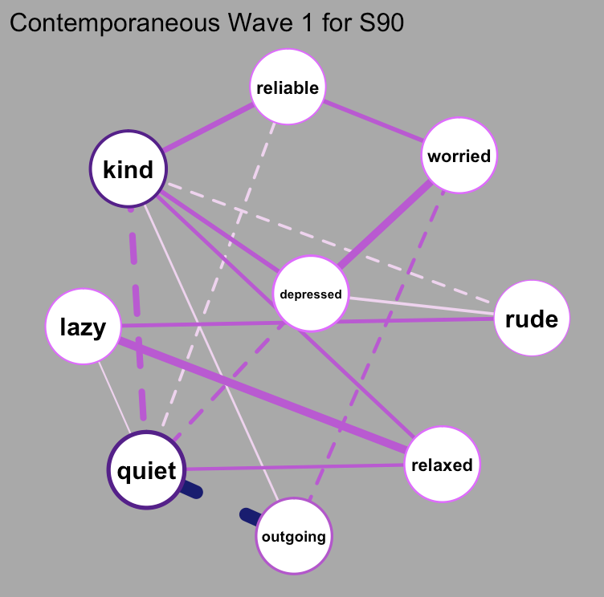
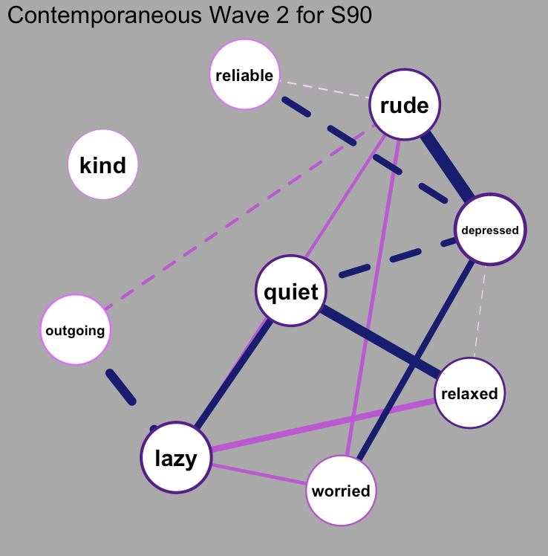
Individual Level Contemporaneous Personality Network Stability
Background | Methods | Temporal | Contemporaneous | Conclusions
N1: Relaxed
N2: Depressed
N3: Worried
E1: Quiet
E2: Outgoing
A1: Rude
A2: Kind
C1: Lazy
C2: Reliable
Subject 90
Want to see more? https://emoriebeck.shinyapps.io/pairs_graphicalvar/

Slide 19
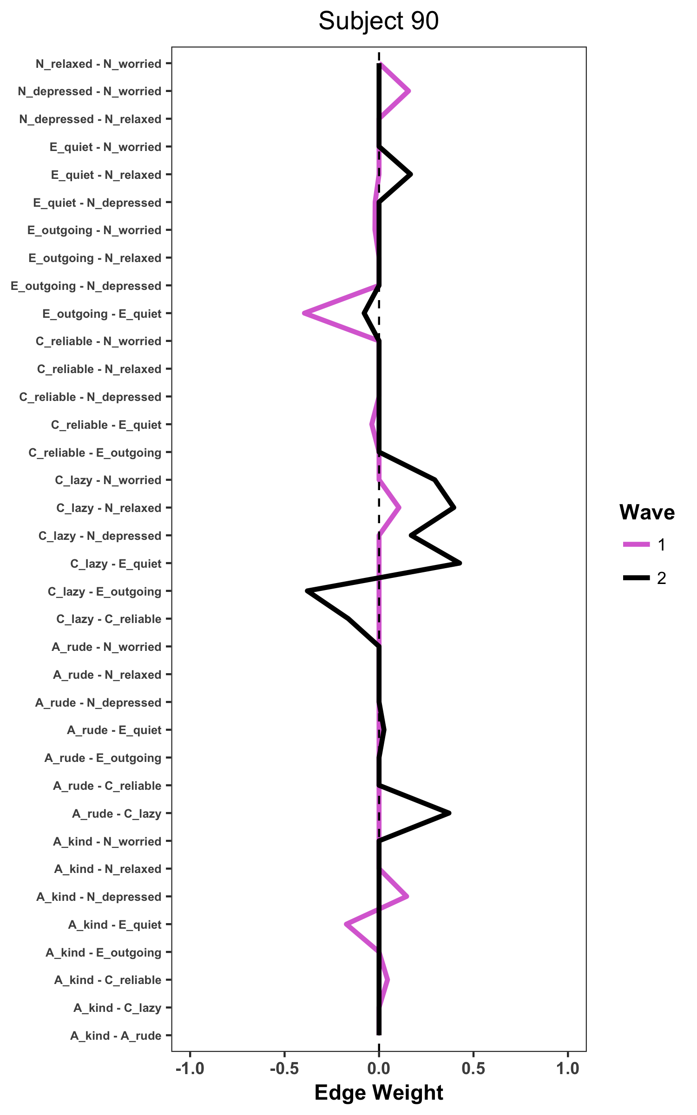
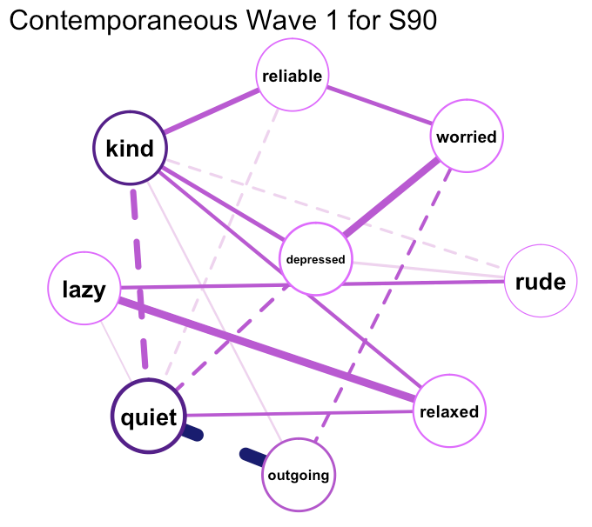
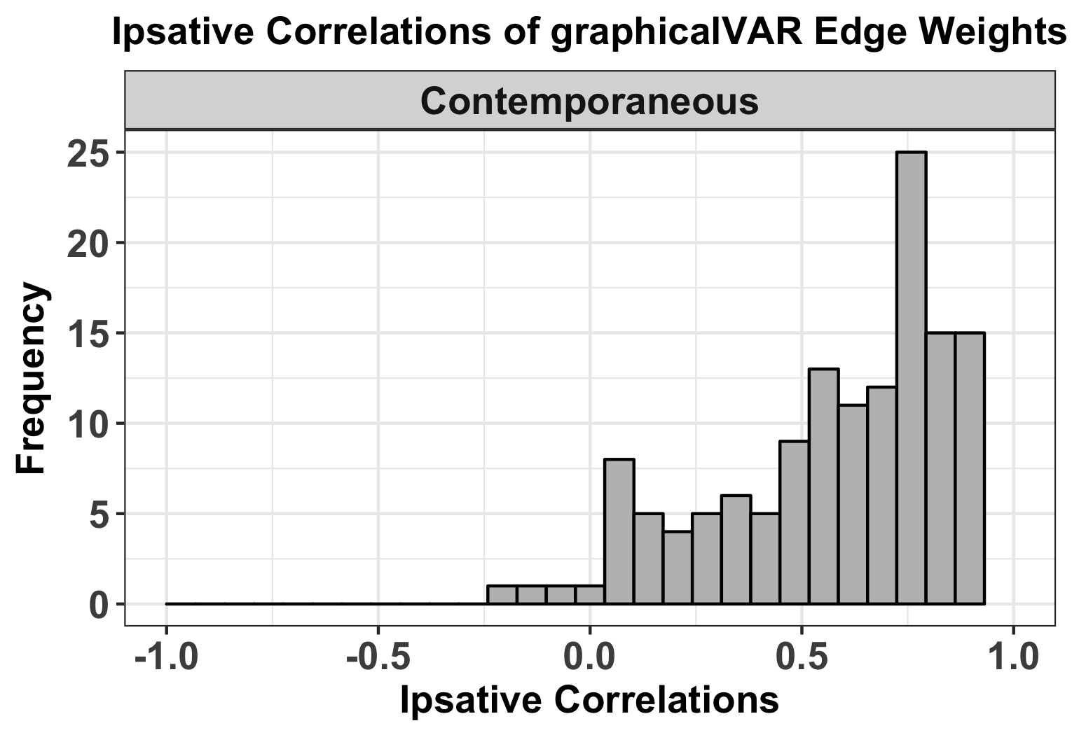
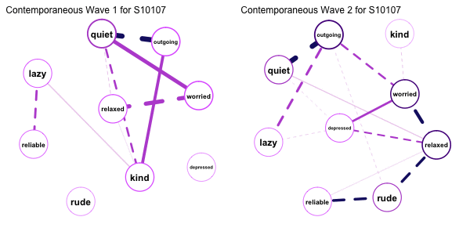
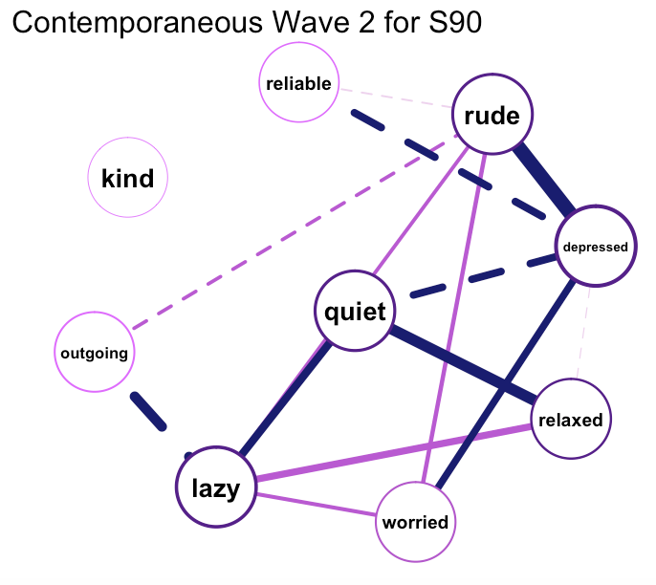
Background | Methods | Temporal | Contemporaneous | Conclusions
Individual Level Contemporaneous Personality Network Stability
N1: Relaxed
N2: Depressed
N3: Worried
E1: Quiet
E2: Outgoing
A1: Rude
A2: Kind
C1: Lazy
C2: Reliable
Subject 90
r = .34
M = .64 (SD = .41)

Slide 20
Conclusions
Background | Methods | Temporal | Contemporaneous | Conclusions
Contemporaneous Idiographic Networks
strong ipsative, weak rank-order and absolute stability
People are changing systematically, but there are individual differences in the degree and direction of change as well as for which variables
Temporal Idiographic Networks
weak ipsative, rank-order, and absolute stability
People are changing, not systematically, and not in a particular direction

Slide 21
Conclusions
Background | Methods | Temporal | Contemporaneous | Conclusions
We can now fit idiographic personality networks
The present results represent of subset of results but there are many more network properties
In this sample, other network properties (density, centrality) were more stable.
Unclear whether lack of stability represents lack of predictive power or measurement issues

Slide 22
Limitations
Background | Methods | Temporal | Contemporaneous | Conclusions
Intercepts
Measurement Interval
Too few variables
Parameter stability uncertain
Absolute Change
Notes:
Intercepts: no framework for unifying mean level differences as well as differences in patterns
Measurement Interval: lack of stability in temporal networks may reflect coarse gap between ESM assessments
Too few variables: Cannot ask or answer questions about Big 5 structure of dynamic, time-series networks
Parameter stability uncertain: Bootstrapping methods for time-series networks still in development
Absolute Change: Not meaningful with two time points and a 1 year gap

Slide 23
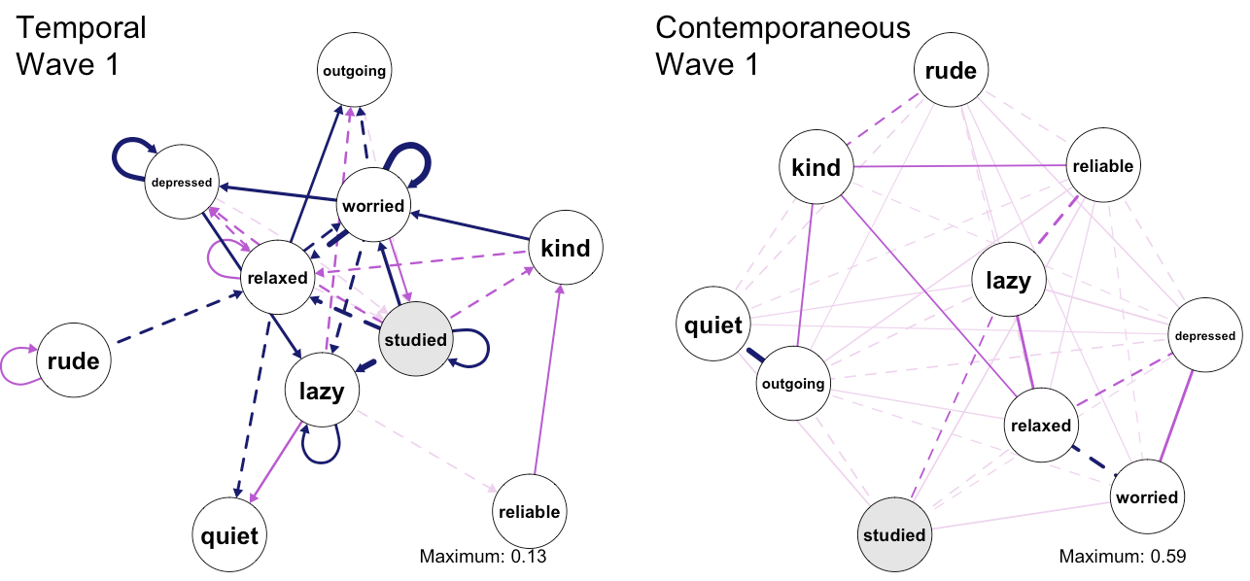
Future Directions
Background | Methods | Temporal | Contemporaneous | Conclusions
Predictive Networks
Modeling personality and momentary behavior
Using idiographic networks to predict long-term outcomes
Personality Network Development Across the Lifespan
Idiographic Networks and Personality Change

Slide 24
Questions?
Background | Methods | Temporal | Contemporaneous | Conclusions
Special Thanks to:
Josh Jackson
The PMaD Lab
(And the people who brought us PAIRS data)
R Code Available at:
https://goo.gl/lC7PDh
Interactive Idiographic Plots Available at:
http://tinyurl.com/pairsnetworks

Slide 25
Background | Methods | Temporal | Contemporaneous | Conclusions
Selected References
Bringmann, L. F., Pe, M. L., Vissers, N., Ceulemans, E., Borsboom, D., Vanpaemel, W., ... & Kuppens, P. (2016). Assessing temporal emotion dynamics using networks. Assessment, 23(4), 425-435.
Bringmann, L. F., Vissers, N., Wichers, M., Geschwind, N., Kuppens, P., Peeters, F., ... & Tuerlinckx, F. (2013). A network approach to psychopathology: new insights into clinical longitudinal data. PloS one, 8(4), e60188.
Costantini, G., Epskamp, S., Borsboom, D., Perugini, M., Mõttus, R., Waldorp, L. J., & Cramer, A. O. (2015). State of the aRt personality research: A tutorial on network analysis of personality data in R. Journal of Research in Personality, 54, 13-29.
Costantini, G., & Perugini, M. (2016). The network of conscientiousness. Journal of Research in Personality, 65, 68-88.
Epskamp, S., & Fried, E. I. (2016). A Primer on estimating regularized psychological networks. arXiv preprint arXiv:1607.01367.
Epskamp, S., Waldorp, L. J., Mõttus, R., & Borsboom, D. (2016). Discovering Psychological Dynamics: The Gaussian Graphical Model in Cross-sectional and Time-series Data. arXiv preprint arXiv:1609.04156.
Schmittmann, V. D., Cramer, A. O., Waldorp, L. J., Epskamp, S., Kievit, R. A., & Borsboom, D. (2013). Deconstructing the construct: A network perspective on psychological phenomena. New ideas in psychology, 31(1), 43-53.
R Packages:
qgraph
igraph
mlVAR
graphicalVAR
dplyr
tidyr
purrr (for many, many idiographic models)

